Slide 1



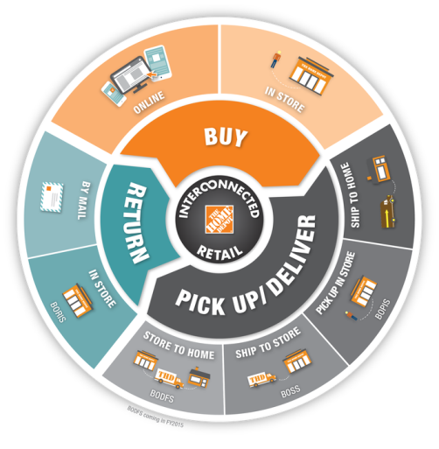
THD Online
Order Stager
A new program for employees to stage online orders for our customers
More Convenient. More Value. The Home Depot Way.
By: Trevor Casey

